Slide 1
Machine Learning: An Overview

Slide 2
What is Learning?
“Learning denotes changes in a system that ... enable a system to do the same task … more efficiently the next time.” - Herbert Simon
“Learning is constructing or modifying representations of what is being experienced.” - Ryszard Michalski
“Learning is making useful changes in our minds.” - Marvin Minsky
“Machine learning refers to a system capable of the autonomous acquisition and integration of knowledge.”

Slide 3
Why Machine Learning?
No human experts
industrial/manufacturing control
mass spectrometer analysis, drug design, astronomic discovery
Black-box human expertise
face/handwriting/speech recognition
driving a car, flying a plane
Rapidly changing phenomena
credit scoring, financial modeling
diagnosis, fraud detection
Need for customization/personalization
personalized news reader
movie/book recommendation

Slide 4
Related Fields
data
mining
control theory
statistics
machine
learning
decision theory
information theory
cognitive science
databases
psychological models
evolutionary
models
neuroscience
Machine learning is primarily concerned with the accuracy and effectiveness of the computer system.

Slide 5
Machine Learning Paradigms
learning by being told (advice-taking)
learning from examples (induction)
learning by analogy
speed-up learning
concept learning
clustering
discovery

Slide 6
Architecture of a Learning System
critic
feedback
performance standard
percepts
ENVIRONMENT
learning
element
changes
performance
element
actions
knowledge
learning goals
problem
generator

Slide 7
Learning Element
Design affected by:
performance element used
e.g., utility-based agent, reactive agent, logical agent
functional component to be learned
e.g., classifier, evaluation function, perception-action function,
representation of functional component
e.g., weighted linear function, logical theory, HMM
feedback available
e.g., correct action, reward, relative preferences

Slide 8
Dimensions of Learning Systems
type of feedback
supervised (labeled examples)
unsupervised (unlabeled examples)
reinforcement (reward)
representation
attribute-based (feature vector)
relational (first-order logic)
use of knowledge
empirical (knowledge-free)
analytical (knowledge-guided)

Slide 9
Outline Machine Learning
Supervised learning
Unsupervised learning
Performance evaluation
Computational learning theory

Slide 10
Inductive (Supervised) Learning
Basic Problem: Induce a representation of a function (a systematic relationship between inputs and outputs) from examples.
target function f: X → Y
example (x,f(x))
hypothesis g: X → Y such that g(x) = f(x)
x = set of attribute values (attribute-value representation)
x = set of logical sentences (first-order representation)
Y = set of discrete labels (classification)
Y = ℜ (regression)

Slide 11
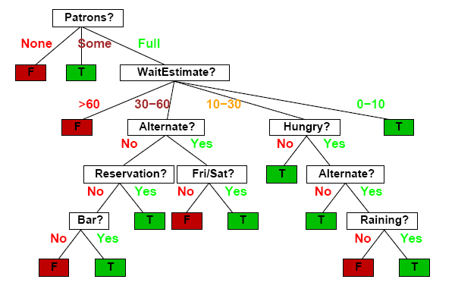
Decision Trees
Should I wait at this restaurant?

Slide 12
Decision Tree Induction
(Recursively) partition examples according to the most important attribute.
Key Concepts
entropy
impurity of a set of examples (entropy = 0 if perfectly homogeneous)
(#bits needed to encode class of an arbitrary example)
information gain
expected reduction in entropy caused by partitioning

Slide 13
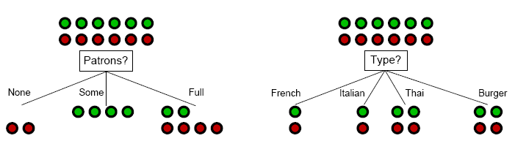
Decision Tree Induction: Attribute Selection
Intuitively: A good attribute splits the examples into subsets that are (ideally) all positive or all negative.

Slide 14
Decision Tree Induction: Attribute Selection
Intuitively: A good attribute splits the examples into subsets that are (ideally) all positive or all negative.

Slide 15
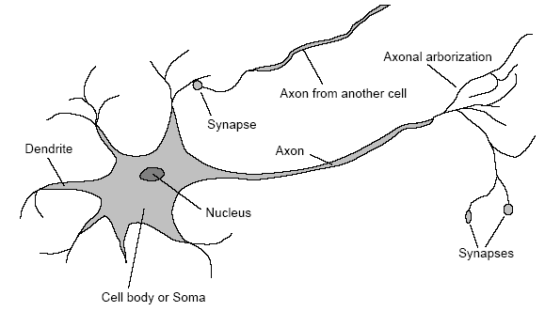
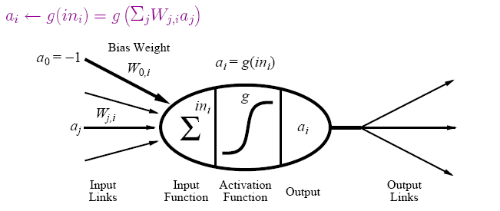
(Artificial) Neural Networks
Motivation: human brain
massively parallel (10¹¹ neurons, ~20 types)
small computational units with simple low-bandwidth communication (10¹⁴ synapses, 1-10ms cycle time)
Realization: neural network
units (≈ neurons) connected by directed weighted links
activation function from inputs to output

Slide 16
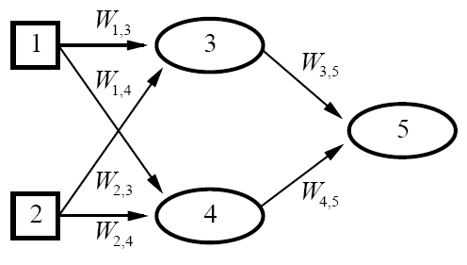

Neural Networks (continued)
neural network = parameterized family of nonlinear functions
types
feed-forward (acyclic): single-layer perceptrons, multi-layer networks
recurrent (cyclic): Hopfield networks, Boltzmann machines
[ connectionism, parallel distributed processing]

Slide 17
Neural Network Learning
Key Idea: Adjusting the weights changes the function represented by the neural network (learning = optimization in weight space).
Iteratively adjust weights to reduce error (difference between network output and target output).
Weight Update
perceptron training rule
linear programming
delta rule
backpropagation

Slide 18
Neural Network Learning: Decision Boundary
single-layer perceptron
multi-layer network

Slide 19
Support Vector Machines
Kernel Trick: Map data to higher-dimensional space where they will be linearly separable.
Learning a Classifier
optimal linear separator is one that has the largest margin between positive examples on one side and negative examples on the other
= quadratic programming optimization

Slide 20
Support Vector Machines (continued)
Key Concept: Training data enters optimization problem in the form of dot products of pairs of points.
support vectors
weights associated with data points are zero except for those points nearest the separator (i.e., the support vectors)
kernel function K(x_{i},x_{j})
function that can be applied to pairs of points to evaluate dot products in the corresponding (higher-dimensional) feature space F (without having to directly compute F(x) first)
efficient training and complex functions!

Slide 21
Support Vector Machines: Decision Boundary
Ф

Slide 22
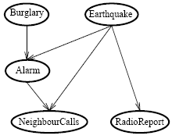
Bayesian Networks
Network topology reflects direct causal influence
Basic Task: Compute probability distribution for unknown variables given observed values of other variables.
[belief networks, causal networks]
 | A B | A ¬B | ¬A B | ¬A ¬B
C | 0.9 | 0.3 | 0.5 | 0.1
¬C | 0.1 | 0.7 | 0.5 | 0.9
conditional probability table
for NeighbourCalls

Slide 23
Bayesian Network Learning
Key Concepts
nodes (attributes) = random variables
conditional independence
an attribute is conditionally independent of its non-descendants, given its parents
conditional probability table
conditional probability distribution of an attribute given its parents
Bayes Theorem
P(h|D) = P(D|h)P(h) / P(D)

Slide 24
Bayesian Network Learning (continued)
Find most probable hypothesis given the data.
In theory: Use posterior probabilities to weight hypotheses. (Bayes optimal classifier)
In practice: Use single, maximum a posteriori (most probable) hypothesis.
Settings
known structure, fully observable (parameter learning)
unknown structure, fully observable (structural learning)
known structure, hidden variables (EM algorithm)
unknown structure, hidden variables (?)

Slide 25
Nearest Neighbor Models
Key Idea: Properties of an input x are likely to be similar to those of points in the neighborhood of x.
Basic Idea: Find (k) nearest neighbor(s) of x and infer target attribute value(s) of x based on corresponding attribute value(s).
Form of non-parametric learning where hypothesis complexity grows with data (learned model ≈ all examples seen so far)
[instance-based learning, case-based reasoning, analogical reasoning]

Slide 26
Nearest Neighbor Model: Decision Boundary

Slide 27
Unsupervised Learning
Learn patterns from (unlabeled) data.
Approaches
clustering (similarity-based)
density estimation (e.g., EM algorithm)
Performance Tasks
understanding and visualization
anomaly detection
information retrieval
data compression

Slide 28
Performance Evaluation
Randomly split examples into training set U and test set V.
Use training set to learn a hypothesis H.
Measure % of V correctly classified by H.
Repeat for different random splits and average results.

Slide 29
Performance Evaluation: Learning Curves
classification accuracy
classification error
#training examples

Slide 30
Performance Evaluation: ROC Curves
false negatives
false positives

Slide 31
Performance Evaluation: Accuracy/Coverage
classification accuracy
coverage

Slide 32
Current Machine Learning Research
Representation
data sequences
spatial/temporal data
probabilistic relational models
…
Approaches
ensemble methods
cost-sensitive learning
active learning
semi-supervised learning
collective classification
…

